Slide 1

Group 6: Simulating and analysing data
2023118959 Mashawana Mpho
2021229915 Mthethwa Bheki
2026206108 Majola Mlibo
2025281227 Maluleke Collins
STSM3734 Assignment 1
2026

Slide 2
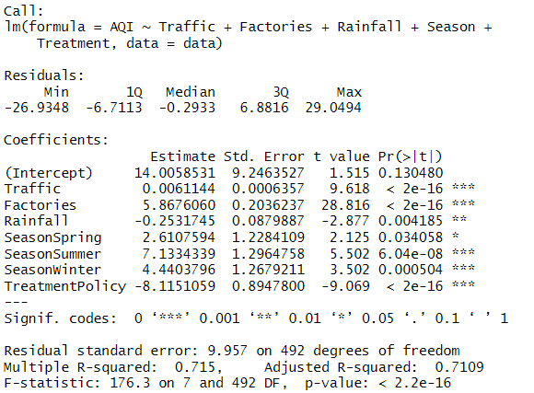
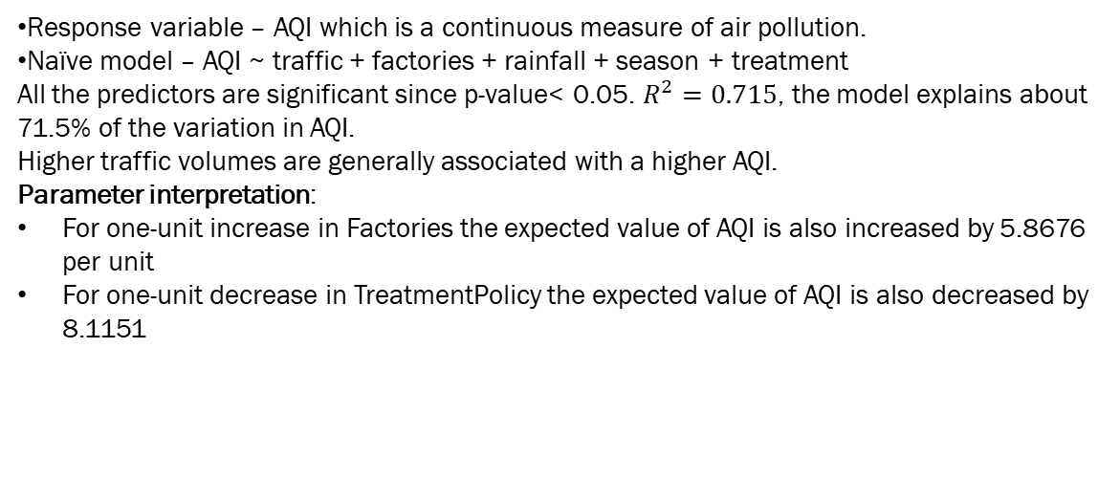
Dataset, response variable & naïve model
Dataset – we are assessing group 5’s observational data of sample size 500 on air quality index(AQI) with predictors :
Traffic (continuous variable)
Factories contribute emissions (continuous variable)
Rainfall reduces AQI by cleaning the air (continuous variable)
Seasons capture meteorological variation (categorical)
Treatment (policy vs no policy) represents intervention. (categorical variable)
Response variable – AQI which is a continuous measure of air pollution.
Naïve model – AQI ~ traffic + factories + rainfall + season + treatment
All the predictors are significant since p-value< 0.05. $R^{2}=0.715$, the model explains about 71.5% of the variation in AQI.
Higher traffic volumes are generally associated with a higher AQI.
Parameter interpretation:
For one-unit increase in Factories the expected value of AQI is also increased by 5.8676 per unit
For one-unit decrease in TreatmentPolicy the expected value of AQI is also decreased by 8.1151

Slide 3
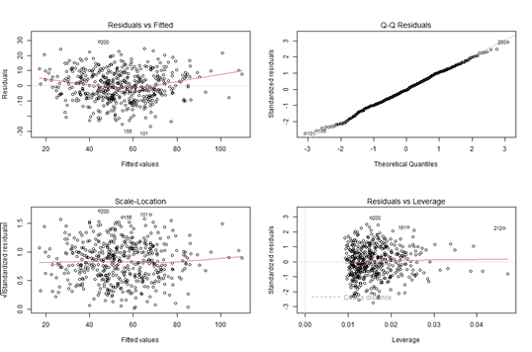
Model refinement
Residuals vs fitted: the red line is more U shaped than horizontal line, we see a distinct non-linear pattern. This suggest that the relationship between predictors like traffic and AQI might not be strictly linear – we suspect there might be a squared term (transformation) or hidden interaction
Normal Q-Q plot: the residuals do deviate but not much which seems suspicious and this might indicate that the model errors are not perfectly normal.
Scale- location plot: the red line of residuals plot is not flat error variance might not be constant.
Residuals vs leverage: there are some points that fall outside of cook’s distance meaning there are influential observation
The naïve model assumed every variable acts independently and linearly. However, our diagnostic show U shaped instead of horizontal and variance seems to be non-constant. This proves the naïve model might be under-specified (missing important predictors).

Slide 4
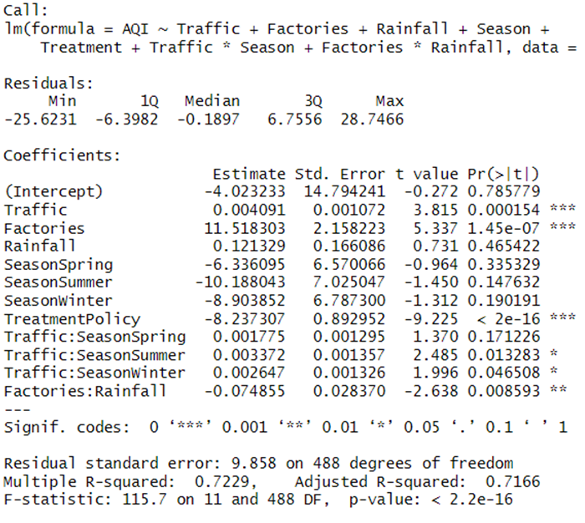
Model refinement (interactions/transformations)
Interactions :
Traffic x season – winter emissions linger longer
Rainfall x factories – rainfall may offset factory emissions
Transformations - Rainfall effect may be nonlinear( heavy rainfall has stronger cleaning effect)
Including interactions improves model fit and highlights context-specific effects
Coefficient interpretation and significance:
For one-unit increase in Factories, holding other variables constant increases the expected value of AQI by 11.5183. It is statistically significant since p-value <0.05
For one-unit increase in Traffic holding other variables constant increases the expected value of AQI by 0.004091. it is statistically significant since p-value <0.05
For one-unit decrease in TreatmentPolicy the expected value of AQI is decreased by 8.2373. and it is statistically significant with the p-value <0.05
Rainfall is not statistically significant since p-value>0.05
The season variable is also insignificant

Slide 5
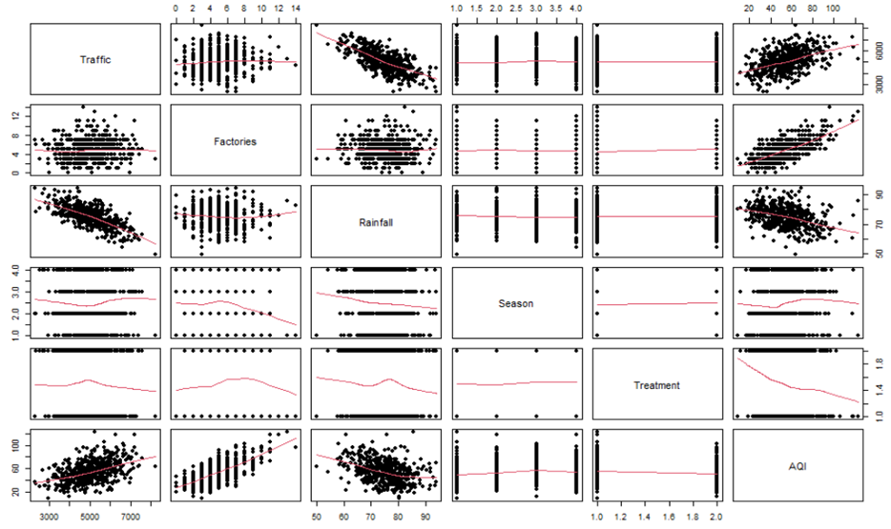
Reflection on observational data
So we experience a correlation issue.
There is almost a linear relationship between Traffic and Factories, the pair plot shows that these predictors are correlated. This is identifiability problem. This is because we did not control the environment.
Here we noticed from the residuals plots that there might be interaction (like Traffic *Season) which we had to look for it because the variables are not balanced.
The relationship between Rainfall and AQI was obscured by seasonality. We observed confounding between Rainfall and Season. if we don't account for these seasonal 'state changes,' our estimates for variables like Rainfall or Traffic become biased
Treatment does not seem to have any significance in AQI since it does not have any correlation with any of the variables

Slide 6
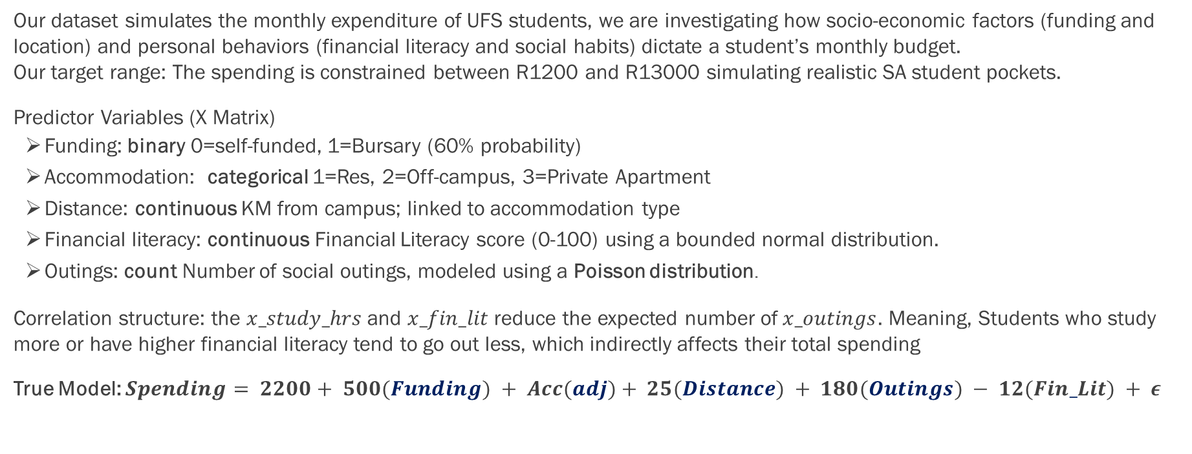
Introduction
Our dataset simulates the monthly expenditure of UFS students, we are investigating how socio-economic factors (funding and location) and personal behaviors (financial literacy and social habits) dictate a student’s monthly budget. Our target range: The spending is constrained between R1200 and R13000 simulating realistic SA student pockets.
Predictor Variables (X Matrix)
Funding: binary 0=self-funded, 1=Bursary (60% probability)
Accommodation: categorical 1=Res, 2=Off-campus, 3=Private Apartment
Distance: continuous KM from campus; linked to accommodation type
Financial literacy: continuous Financial Literacy score (0-100) using a bounded normal distribution.
Outings: count Number of social outings, modeled using a Poisson distribution.
Correlation structure: the $x_study_hrs$and $x_fin_lit$reduce the expected number of$x_outings$. Meaning, Students who study more or have higher financial literacy tend to go out less, which indirectly affects their total spending
True Model: $Spending= 2200+ 500(Funding) + Acc(adj)+ 25(Distance) + 180(Outings) − 12(Fin_Lit) + ε$

Slide 7
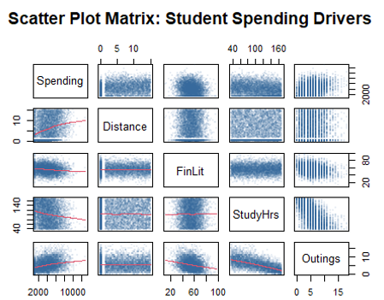
Scatterplot matrix & interpretation
The scatterplot shows clear relationships between spending and our predictors.
Distance – spending : has a positive trend, farther students tend to spend more. observational correlation may be inflated by confounding( e.g., accommodation type)
FinLit – spending : negative relationship, higher literacy reduces spending.
Outings – spending : strong positive correlation, more outings, higher spending.

Slide 8
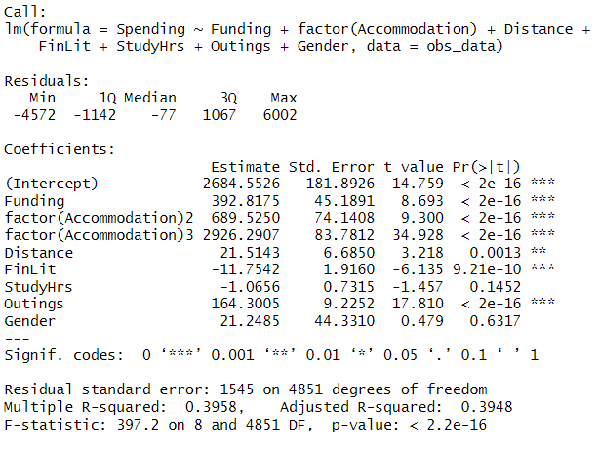
True vs estimated model

Slide 9
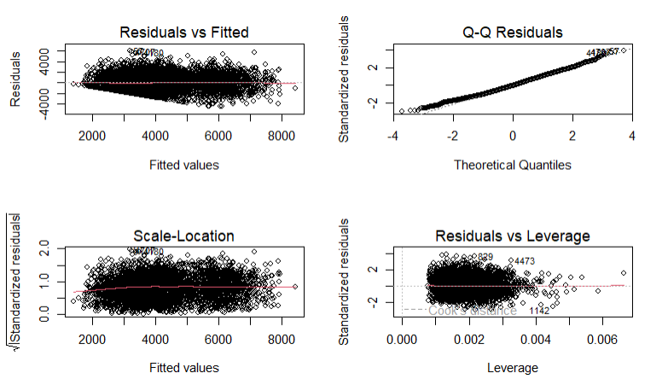
Reflection on observational data
Residuals vs fitted – the red smooth line shows slight curvature, meaning the model doesn’t fully capture the relationships. This indicates possible non-linearity or confounding.
Q-Q plot – residuals deviate from the diagonal at the tails, suggesting the errors are not perfectly normally distributed.
Scale- location plot – spread of the residuals increases with fitted values, showing heteroscedasticity (unequal variance).
Residuals vs leverage – a few points have higher leverage, meaning certain observations may unduly influence the model.
variables like FinLit, StudyHrs, and Outings were correlated, creating confounding and multicollinearity.
So, what we found to be hard was that these correlated variables made it harder for a regression model to isolate the exact effect of a single variable on student spending.

Slide 10
Experimentalization process & orthogonality
Here is where we moved from the messy, correlated observational data to a structured balanced design where every variable is independent of the others. We started by using expand.grid and rep to ensure every possible combination of variables has an equal number of students. This achieves orthogonality, meaning our predictors are no longer correlated. We then converted continuous predictors into categorical to create a balanced, orthogonal X matrix.
Creation of the balanced grid: Using the expand.grid function, we generated every possible combination of our 6 factors: Funding (2) *Acc (3) * Distance (2) * FinLit (3) * StudyHrs (3) * Outings (3)
Cell size and sample size: total unique cells =324. We then replicated each cell 15 times (each = 15) to reach a total N=4860 observations. This ensures 15 observations per interaction cell, providing enough power to estimate effects without bias. This means a student's Distance is now completely independent of their Accommodation type or Funding.
Impact on Variance: by controlling the X matrix, we minimize the variance of our coefficient estimates, allowing for much more efficient "recovery" of the true model parameters compared to the observational data.
In summary – The experimentalisation process was executed using expand.grid to create a 324-cell balanced design, ensuring orthogonality across all predictors. By discretizing continuous variables into categorical tertiles and replicating each cell 15 times (N=4860), we ensured a diagonal 𝑋^𝑇 𝑋 matrix. This design eliminates the confounding found in the observational data.

Slide 11
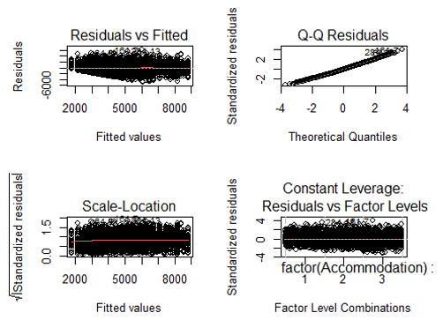
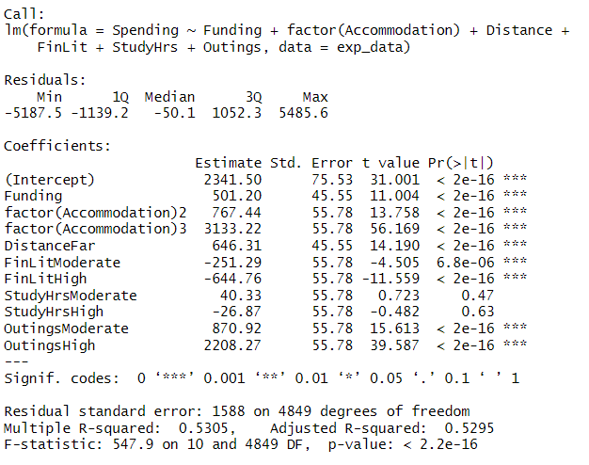
Naïve experimental model & diagnostics

Slide 12
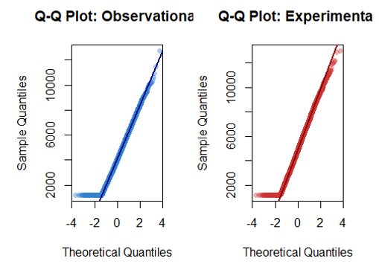
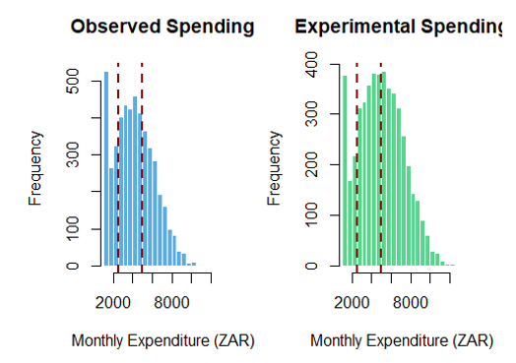
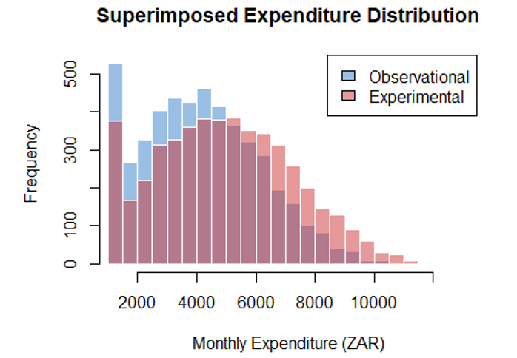
Observational vs experimental distributions
We are comparing spending distributions.
The Q-Q plots show deviations from normality.
The observational histogram shows more variability , reflecting confounding & real-world noise. Experimental histogram is more structured because of balance and orthogonality.
Superimposed histogram shows overlap in ranges, confirming that both datasets reflect realistic student spending.

Slide 13
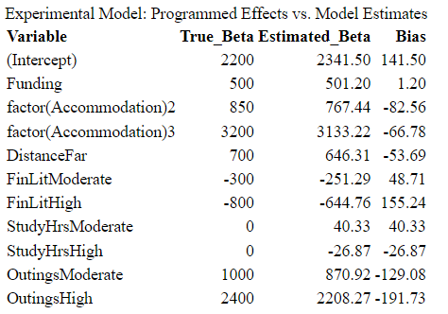
True vs estimated model
The table compares true model coefficients with the experimental model coefficients.
The estimates of the main drivers of spending are very close to the true value, with only a small bias. This shows that experimentalisation recovers the true effects reliably.
By balancing and orthogonalizing the design, we separate genuine effects from noise, showing that experimental regression clarifies inference in a way observational data cannot.

Slide 14
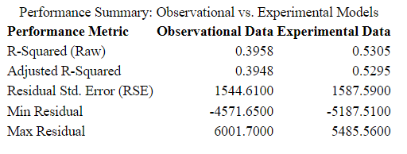

Reflection on experimentalisation
$R^{2}$ increased from 0.3958 (observational) to 0.5305 (experimental).
Adjusted $R^{2}$ shows the same improvement, confirming stronger explanatory power.
Experimentalisation created balance and orthogonality, removing overlaps between predictors. This eliminated spurious correlations that misled the observational model.
Residuals are more stable, bias across estimates is small.
Experimentalisation improved the model accuracy. By balancing and orthogonalizing the design, it separated signal from noise and produced valid inference.

